Slide 1
Towards distributed Image Reconstruction

Slide 2
Who am I?
Jonas Schwammberger
Institute 4 Data Science @ FHNW
Masters degree in CS
If you have a question, just shout

Slide 3
What am I talking about
Distributing the major/minor cycle using MPI and .netcore (C#)
Distributed gridding is based on the Image Domain Gridder (IDG)
Focus on distributing the minor cycle
Work in progress

Slide 4
Major/Minor Cycle

Slide 5
Distributed gridding
< 1%
Non-Zero Pixels
~ 4 GB
32k * 32k image
1000+ GB

Slide 6
But what about the minor cycle?
Deconvolution may become the most time consuming step
Deconvolution is done only on one node
All other nodes idle during deconvolution
We can use the idling nodes for deconvolution

Slide 7
Minor cycle distribution can exploit the data properties
How large is the PSF
How large is the grid vs. the calibrated Visibilities
How sparse is the model image
…
Test on a real world MeerKAT observation

Slide 8
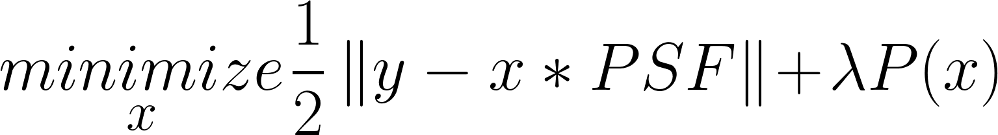
Compressed Sensing based deconvolution
P() represents the prior knowledge about our image
Optimization algorithm needed, Gradient Descent, ADMM…
CLEAN can be seen as a Compressed Sensing based deconvolution

Slide 9
Compressed Sensing based deconvolution
P() → ElasticNet
Optimization Algorithm → Coordinate Descent

Slide 10
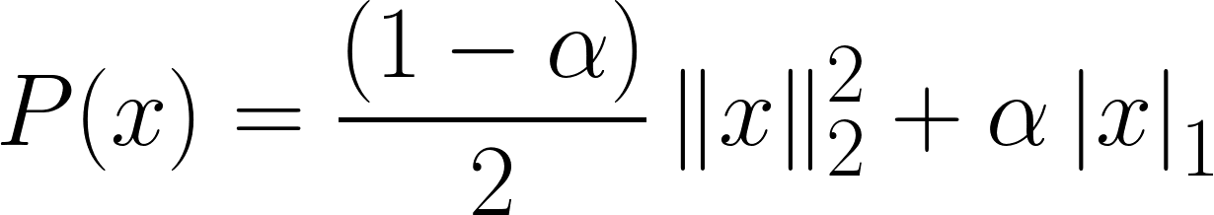


ElasticNet Prior
Mixture between L1 and L2 Norm

Slide 11
Coordinate Descent algorithm
Algorithm:
Minimizes one pixel at a time
Iterate over pixels (with some strategy) until convergence
Effective for high-dimensional problems
Parallel/Distributed/GPU variants

Slide 12
Distributed Coordinate Descent

Slide 13
Distributed major / minor cycle

Slide 14
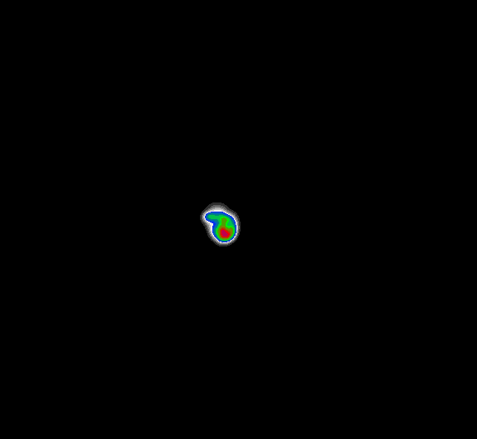

Preliminary Results
1 Node vs 4 Nodes
Speedup of a factor 3.2

Slide 15
Limitations
Distributed Coordinate Descent is latency limited
GPU Acceleration
Data volume not (yet) representative

